Slide 1
Chapter 2
Ohm’s Law
D.C. Kulshreshtha

Slide 2
Topics to be Discussed
Ohm’s Law.
Short Circuit and Open Circuit.
Switches.
Resistance.
Voltage Divider.
Current Divider.
Star-Delta Connections .
Duality.
Ch. 2 Ohm's Law

Slide 3
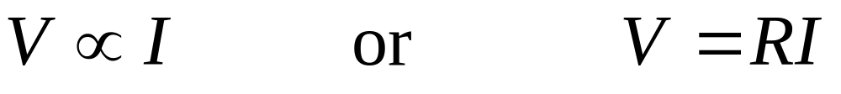
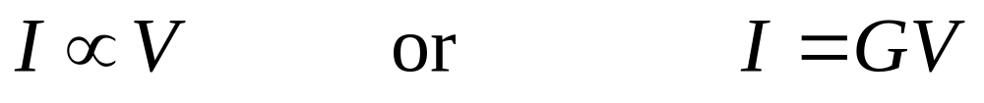
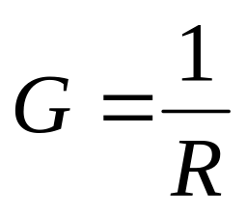
Ohm’s Law
R is called resistance, measure in ohm (Ω).
Another way of stating Ohm’s law,
G is called conductance, measured in siemens (S).
Obviously,
Ch. 2 Ohm's Law

Slide 4
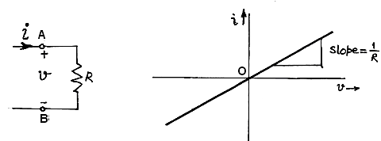
Ohm’s Law in Graphical Form
Ch. 2 Ohm's Law

Slide 5
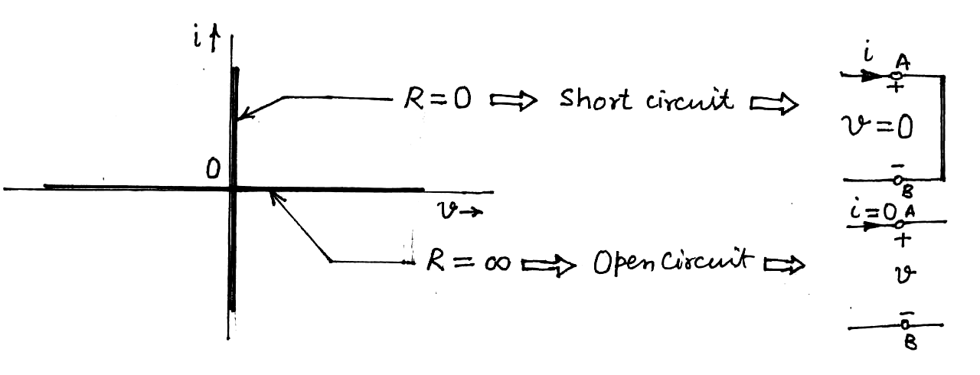
Short Circuit and Open Circuit
Ch. 2 Ohm's Law

Slide 6
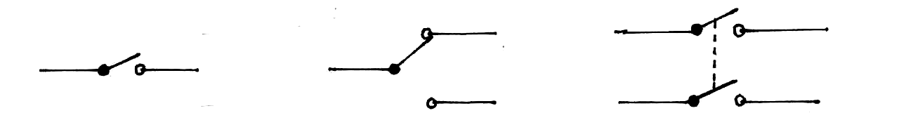

Switches
Single-pole, single-throw switch
Single-pole, double-throw switch
Double-pole, single-throw switch
Ch. 2 Ohm's Law

Slide 7
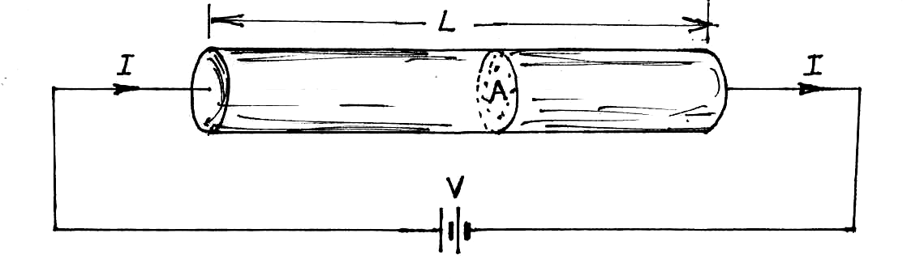
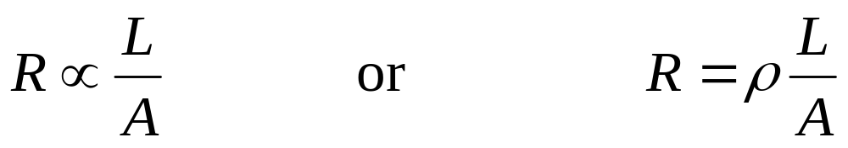
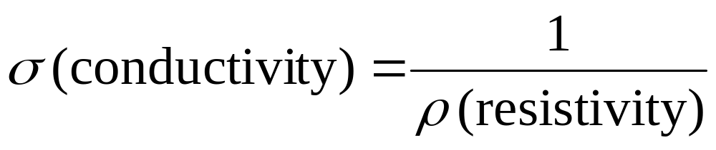
Resistance
ρ is resistivity, measured in ohm metre (Ω m).
Inverse of resistivity is conductivity, i.e.,
Ch. 2 Ohm's Law

Slide 8
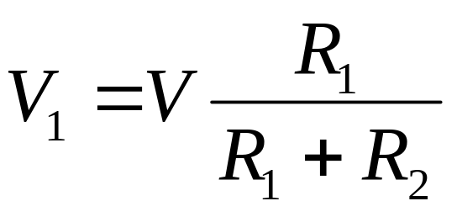
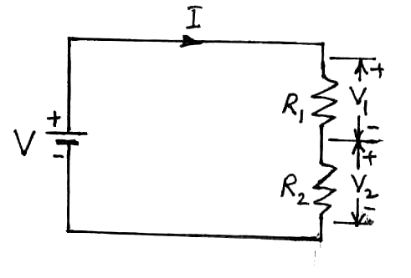
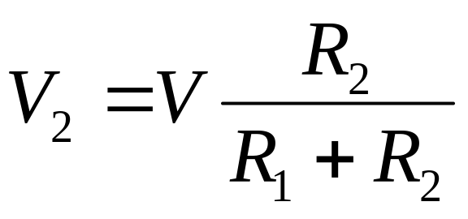
Voltage Divider
The voltage appearing across one of the series resistances is the total voltage times the ratio of its resistance to the total resistance.
Ch. 2 Ohm's Law

Slide 9

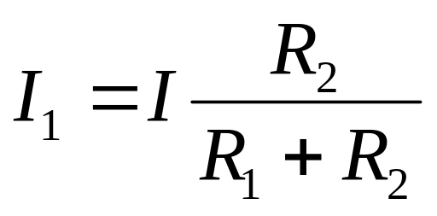
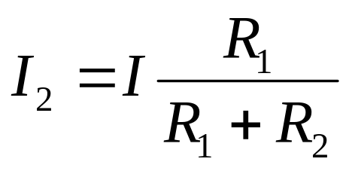
Current Divider
The current through one of the two parallel resistors is the total current times the ratio of the other resistance to the sum of resistances.
Ch. 2 Ohm's Law

Slide 10
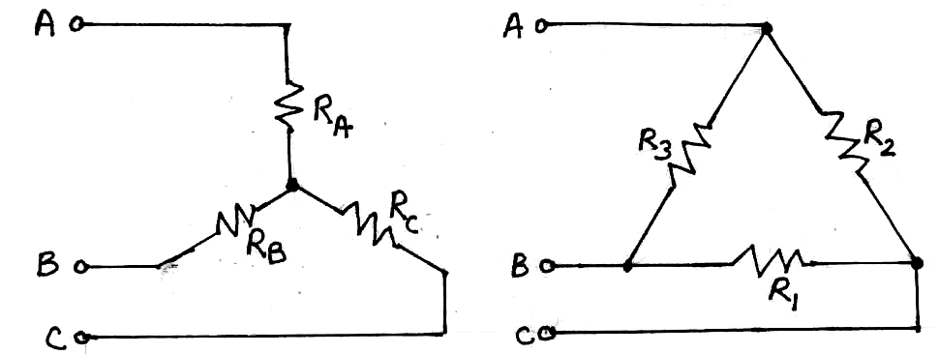
Star-Delta Connections :
Two ways of connecting three resistors across three points.
(a) Star (Y) connection (b) Delta (∆) connection
Ch. 2 Ohm's Law

Slide 11

Delta-to-Star Transformation
Y and ∆ superimposed
Ch. 2 Ohm's Law

Slide 12
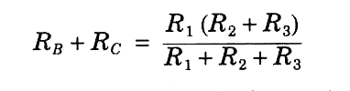
If the two arrangements are to be equivalent, the resistance between any pair of terminals (AB, BC or CA) in the two circuits has to be the same, when the third line is left open.
Keeping terminal A open, we equate the resistance between terminals B and C in the two circuits,
Ch. 2 Ohm's Law

Slide 13


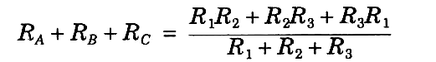
Similarly,
Adding above three equations and dividing by 2, we get
Ch. 2 Ohm's Law

Slide 14
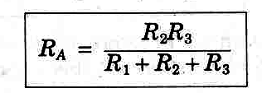
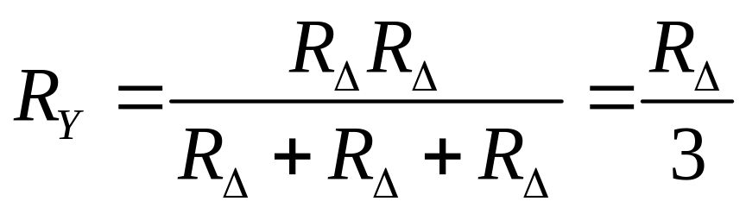
Subtracting,
Remember : Product of two resistances on its sides, divided by the sum of three resistances.
For a symmetrical delta-connection,
Ch. 2 Ohm's Law

Slide 15
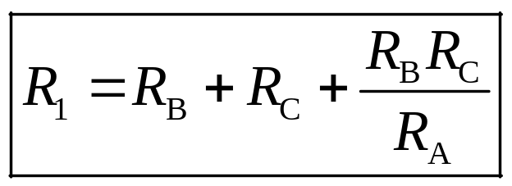
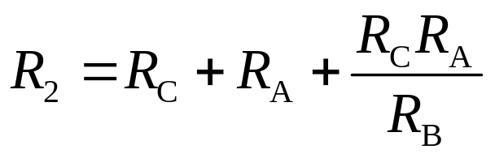
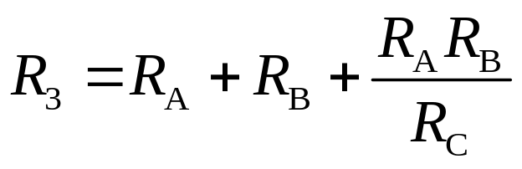
Star-to-Delta Transformation
Same way, we can derive,
Remember
The sum of the two nearest resistances plus the product of the same two resistances divided by the third resistance.
Ch. 2 Ohm's Law

Slide 16
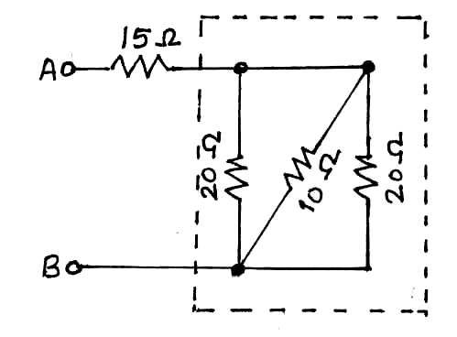
Example 1 Calculate the effective resistance between points A and B for the combinations of resistances,
Ch. 2 Ohm's Law

Slide 17
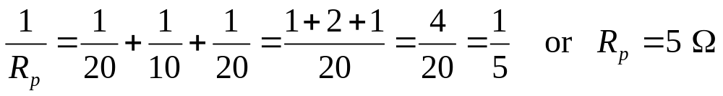
Solution : The resistance R_{p} of the network within the dotted box is given by
Therefore,
R_{AB} = 15 Ω + (20 Ω || 10 Ω || 20 Ω)
= 15 Ω + 5 Ω = 20 Ω
Alternatively, much easier and quick solution :
R_{AB} = 15 Ω + (20 Ω || 20 Ω) || (10 Ω)
= 15 Ω + (10 Ω) || (10 Ω) = 15 Ω + 5 Ω = 20 Ω
Above calculation can be done orally in just one minute !
Ch. 2 Ohm's Law

Slide 18

DUALITY
Two circuits are said to be dual of each other, if the voltage equations for the one have the same mathematical form as the current equations for the other.
The form of equations remain the same, if
Current Voltage
Series Parallel
Resistance Conductance
Short circuit Open circuit
Closed switch Open switch
Ch. 2 Ohm's Law

Slide 19
Review
Ohm’s Law.
Short Circuit and Open Circuit.
Switches.
Resistance.
Voltage Divider.
Current Divider.
Star-Delta Connections .
Duality.
Ch. 2 Ohm's Law

